Slide 1
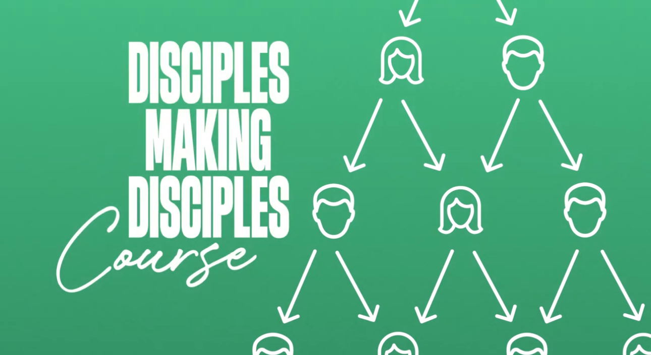
Disciples Making Disciples
Lesson One

Slide 2
Expectations/Purpose of Taking this Class
Come to Class Prepared.
You will gain the skills needed to be a disciple-maker.

Slide 3
Expectations/Purpose of Taking this Class
Once you complete the class you will start to disciple another person.
You will be challenged to grow spiritually.

Slide 4
What is a Disciple? Week 1 / Pages 1-14

Slide 5
The Definition of a Disciple
A disciple is a person who follows Jesus – to know Jesus and his teaching; to grow more like Jesus; to go for Jesus, serving others, and making new disciples (Source: Rose Guide to Discipleship).

Slide 6
What a Disciple Isn’t

Slide 7
What is Biblical Discipleship? Week 1

Slide 8
Disciples Making Disciples
¹⁹ ”Therefore, go and make disciples of all nations, baptizing them in the name of the Father and of the Son and of the Holy Spirit, ²⁰ and teaching them to obey everything I have commanded you. And surely I am with you always, to the very end of the age.”
The Great Commission Matthew 28:19-20

Slide 9
Characteristics of a Disciple
Devoted: Luke 9:23
Directives: Matt. 22:37-40
Declare: Revelation 12:17b

Slide 10
Disciples Making Disciples
Jesus said, “If anyone would come after me, let him deny himself and take up his cross daily and follow me.”
The Devoted Disciple Luke 9:23

Slide 11
Disciples Making Disciples
³⁷ Jesus replied: "Love the Lord your God with all your heart and with all your soul and with all your mind.' ³⁸ This is the first and greatest commandment. ³⁹ And the second is like it: 'Love your neighbor as yourself.' ⁴⁰ All the Law and the Prophets hang on these two commandments.”
The Disciple’s Daily Directive Matthew 22:37-40

Slide 12
Disciples Making Disciples
…those who keep the commandments of God and hold to the testimony of Jesus.
The Disciple’s Declaration Revelation 12:17b

Slide 13
Disciples Making Disciples Whoever claims to live in Him must walk as Jesus did. 1 John 2:6

Slide 14
Jesus’ Promise to the Faithful Disciple
¹⁹ "Come, follow Me," Jesus said, "and I will make you fishers of men." ²⁰ At once they left their nets and followed him.
Matthew 4:19-20

Slide 15
Disciples Making Disciples
The question is not, are you making disciples?
But the question is: What kind of disciples are you making?

Slide 16
Who Can you Disciple? Week 1 / Pages 13-14

Slide 17
Disciples Making Disciples

Slide 18
Disciples Making Disciples
Lesson Two

Slide 19
What is a Disciple?

Slide 20
What is Biblical Discipleship?

Slide 21
Have you prayed about who you can disciple?

Slide 22
Five things Disciples who Delight in God Consistently Do. Week 2 Pages 162-165

Slide 23
Disciples Delight In Five Things
1. Remain In Christ (John 15:1-8).
2. Scripture (Joshua 1:8; 2 Timothy 3:16).
3. Prayer (John 15:7; Philippians 4:6-7).
4. Fellowship (Matthew 18:20; Hebrews 10:24-25).
5. Declaring the Gospel (Matthew 4:19; Romans 1:16).

Slide 24
Disciples Making Disciples
⁵ Examine yourselves to see whether you are in the faith; test yourselves. Do you not realize that Christ Jesus is in you--unless, of course, you fail the test?
2 Corinthians 13:5

Slide 25
Disciples Making Disciples
Spiritual Evaluation
Pages 163-165
Fill out Evaluation
Pair Up & Share with another person

Slide 26
Disciples Making Disciples
Spiritual Evaluation Results
Praise God for areas of strength!
Pray for areas of spiritual growth!

Slide 27
Disciples Making Disciples

Slide 28
Disciples Making Disciples
Lesson Three

Slide 29
Review

Slide 30
Have you prayed about who you can disciple?

Slide 31
Using This Study Week 3 / Pages 13-17

Slide 32
The Three Main Sections of this Book
Section 1: Delight in God.
Section 2: Declare the Gospel.
Section 3: Disciple Others.

Slide 33
Bible Study Sections
1. Hook: This first step is meant to grab the attention of the person being discipled.
2. Book: This second step focuses on the biblical text by reading the passage and then giving a brief explanation.
3. Look: This third step begins the process of the applying the passage to the disciple’s life.
4. Took: This fourth step continues the application process by the giving the disciple action steps to live out.

Slide 34
Ask the 5 Ws of Bible Study
1. Ask, “Who?” Who are you reading about? Who was involved?
2. Ask, “What?” What is the author talking about? What happens?
3. Ask, “When?” When did this event happen?
4. Ask, “Where?” Where did this story take place?
5. Ask, “Why?” Why is the passage here? Why did it happen?

Slide 35
Bible Study Sections
1. Hook: This first step is meant to grab the attention of the person being discipled.
2. Book: This second step focuses on the biblical text by reading the passage and then giving a brief explanation.
3. Look: This third step begins the process of the applying the passage to the disciple’s life.
4. Took: This fourth step continues the application process by the giving the disciple action steps to live out.

Slide 36
The Great Commandment
³⁴ But when the Pharisees heard that he had silenced the Sadducees, they gathered together. ³⁵And one of them a lawyer, asked him a question to test him. ³⁶ “Teacher, which is the great commandment in the Law?”
The Great Commandment Matthew 22:34-36

Slide 37
The Great Commandment
³⁷ Jesus replied: "Love the Lord your God with all your heart and with all your soul and with all your mind.' ³⁸ This is the first and greatest commandment. ³⁹ And the second is like it: 'Love your neighbor as yourself.' ⁴⁰ All the Law and the Prophets hang on these two commandments.”
The Great Commandment Matthew 22:37-40

Slide 38
The Great Commandment Summarized
1. Disciples Delight in God: “Jesus said to him, “You shall love the Lord your God with all your heart, with all your soul, and with your mind.”
2. Disciples Declare the Gospel: “ A second likewise is this, “You shall love your neighbor as yourself.”

Slide 39
Disciples Making Disciples
Bible Study
Great Commandment
Matthew 22:34-40
Pages 15-17
Pair Up and do the Bible Study together

Slide 40
Homework Assignment
Bible Study
Remain in Christ
John 15:1-17
Pages 168-175

Slide 41
Disciples Making Disciples

Slide 42
Disciples Making Disciples
Lesson Four

Slide 43
Have you prayed about who you can disciple?

Slide 44
Remain in Christ Week 4/ Pages 168-175

Slide 45
Disciples Making Disciples
Scripture Reading & Bible Lesson
John 15:1-8

Slide 46
The Vine and Vinedresser (v.1)
I am the true Vine.
My Father is the Vinedresser.

Slide 47
Two Types of Branches (v.2)
The first branch does not bear fruit.
The second branch bears fruit and is pruned.

Slide 48
Cleansed by the Word (v.3)
The Word of God washes our sins away.
The Word of God Saves (Rom. 1:16)
The Word of God Sanctifies (John 17:17)

Slide 49
Remain in Christ (v.4-5)
Jesus uses the word abide four times in these two verses.
Abide means to stay, dwell, remain, or endure.

Slide 50
Remain in Christ (v.4-5)
Question: Why does Jesus tell us to abide in him?

Slide 51
Remain in Christ (v.4-5)
Question: Why does Jesus tell us to abide in him?
Answer: “For apart from me you can do nothing”

Slide 52
What does it mean to abide in Christ?
Pastor Jim says it means: “We are continually walking with Christ. We will give evidence of this in word and deed.”

Slide 53
The Warning (v.6)
Who are the burned branches?
Three interpretations of this verse.

Slide 54
Abide in Me and My Words (v.7-8)
1. Pray according to the will of God.
2. Glorify God by bearing fruit and proving to be a disciple of Christ.

Slide 55
Disciples Making Disciples

Slide 56
Personal Reflection Question
What sin, stuff, or satisfaction keeps you from bearing fruit?

Slide 57
Disciples Making Disciples
Bible Study/Remain in Christ
John 15:1-17
Pages 171-175
Break up in groups of four and
do the bible study together.

Slide 58
Homework Assignment
Bible Study
Scripture
Matthew 13:1-23
Pages 176-183

Slide 59
Disciples Making Disciples

Slide 60
Disciples Making Disciples
Lesson Five

Slide 61
Have you prayed about who you can disciple?

Slide 62
Scripture Week 5 / Pages 176-183

Slide 63
Four Times A Week in the Bible Video
Bible Matters - 4 times a week impact (youtube.com)

Slide 64
Why the Bible Matters?
God’s Word is: Inspired
God’s Word is: Inerrant
God’s Word is: Infallible
God’s Word is: Authoritative

Slide 65
The Significance of Scripture in:
The life of Israel (Joshua 1:8).
The life of the Church (2 Timothy 3:16-17).

Slide 66
The Significance of Scripture in the Old Testament
Do not let this Book of the Law depart from your mouth; meditate on it day and night, so that you may be careful to do everything written in it. Then, you will be prosperous and successful.
Joshua 1:8

Slide 67
The Significance of Scripture in the New Testament
All Scripture is breathed out by God and profitable for teaching, for reproof, for correction, and for training in righteousness, that the man of God may be complete, equipped for every good work.
2 Tim. 3:16-17

Slide 68
Four-Fold Purpose of Scripture
Teaching: Tells me what I need to Know.
Reproof: Tells me what I need to Stop.
Correction: Tells me what I need to Change.
Training in Righteousness: Tells me what I need to Do.

Slide 69
Do you have a plan?
“If you fail to plan, you are planning to fail.” – Benjamin Franklin

Slide 70
The Three P’s
Plan: Have a plan to read the bible systematically.
Note: Check our website for a listing of bible reading plans.
Prepare: Have a set time and location for Bible reading.
Partner: Meet with another disciple weekly.

Slide 71
The A.B.C.s of Quiet Time
Ask God to instruct you from His Word.
Bible reading plan. (Check website for a plan.)
Communicate with God through prayer.

Slide 72
What tools do you have in your toolbox?
What quiet time tools do you use?
What is your Bible Reading Plan?
Briefly share your answers with the class.
For additional Bible reading plans please visit the Go & Tell website.

Slide 73
Disciples Making Disciples
Bible Study/Matthew 13:1-23
Scripture
Pages 180-183
Break up in groups of four and
do the bible study together.

Slide 74
Closing Quote
“The Scriptures were not given to increase our knowledge but to change our lives.” – D.L. Moody

Slide 75
Homework Assignment
Bible Study
Prayer
Luke 11:1-13
Pages 184-195

Slide 76
Disciples Making Disciples

Slide 77
Disciples Making Disciples
Lesson Six

Slide 78
Have you prayed about who you can disciple?

Slide 79
Prayer Week 6 / Pages 184-195

Slide 80
Disciples Making Disciples
Scripture Reading & Bible Lesson
Luke 11:1-13

Slide 81
Christ’s Prayer (v. 1)
1. It happened in a certain place.
2. It stirred up a question.

Slide 82
The Pattern for Prayer (vv. 2-4)
1. Person: God the Father.
2. Promise: Your Kingdom to Come.
3. Provide: For our Daily Needs.

Slide 83
The Pattern for Prayer (vv. 2-4)
4. Pardon: Forgive us of our sins.
5. Protection: Keep us from temptation.

Slide 84
Christ’s Two Parables on Prayer (vv. 5-13)
The Persistent Friend (vv.5-10).
The Faithful Father (vv. 11-13).

Slide 85
Disciples Making Disciples
Prayer Tools
Pages 189-191
What tools do you use?
Share with each other

Slide 86
How To P.R.A.Y. Acrostic
Praise: I will praise God.
Repent: I will confess and repent of sin.
Ask: I will ask God to meet my needs.
Yield: I will yield to God’s leading.

Slide 87
The B.L.E.S.S. Acrostic
Body: Physical Health/Protection from injury.
Labor: Work, business, and employment.
Emotions: Joy, Peace, and victory over anxiety and depression.

Slide 88
The B.L.E.S.S. Acrostic
Social Relationships: Marriage, Family, Friends and Co-workers.
Spiritual Relationships: Salvation, Walk with Jesus and Church.

Slide 89
Disciples Making Disciples
Bible Study/Prayer
Luke 11:1-13
Pages 184-195
Break up in groups of four and
do the bible study together.

Slide 90
Homework Assignment
Bible Study
Fellowship
John 13:1-17
Pages 196-203

Slide 91
Disciples Making Disciples

Slide 92
Disciples Making Disciples
Lesson Seven

Slide 93
Have you prayed about who you can disciple?

Slide 94
Fellowship Week 7/ Pages 196-203

Slide 95
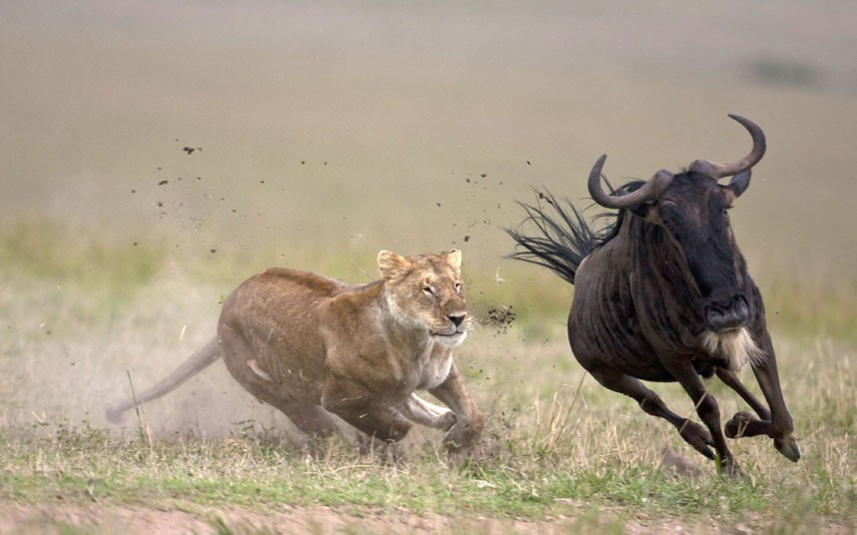
Why Is Fellowship Important?

Slide 96
Disciples Making Disciples
And they devoted themselves to the apostles’ teaching and the fellowship, to the breaking of bread and the prayers.
^{Acts 2:42}

Slide 97
Four Reasons for Gathering in God’s House
Teaching: Instruction in Sound Doctrine.
Fellowship: Accountability with Others.
Communion: Remembering Jesus’ death.
Prayer: Individually and Collectively.

Slide 98
Disciples Making Disciples
²⁴ And let us consider how to stir up one another to love and good works, ²⁵ not neglecting to meet together, as is the habit of some, but encouraging one another, all the more as you see the Day drawing near.
Hebrews 10:24-25

Slide 99
Why Gather in God’s House?
Consider Those in Christ: Think about them.
Stir Up the Saints: To Love and Good Works.
Encourage Everyone: As the Day draws near.

Slide 100
Disciples Making Disciples
Bible Study/John 13:1-17
Pages 200-203
Break up in groups of four and
do the bible study together.

Slide 101
Homework Assignment
Bible Study
Declare the Gospel
Matthew 27:45-56
Pages 204-212

Slide 102
Disciples Making Disciples

Slide 103
Disciples Making Disciples
Lesson Eight

Slide 104
Have you prayed about who you can disciple?

Slide 105
Declare the Gospel Week 8/ Pages 204-212

Slide 106
Tell Me Your Testimony
Your Life Before You Came to Christ.
Your Conversion Experience.
Your New Life in Christ.

Slide 107
F.I.R.E Acrostic
F stands for Family. Tell me about your family.
I stands for Interest. What are your hobbies?
R stands for Religious background. What is your religious or spiritual background?
E stands for Explore. May I ask you a spiritual question?

Slide 108
L.A.W. Acrostic
L stands for: Let’s look at God’s Law.
A stands for: Are you innocent or guilty before God?
W stands for: Where would you go heaven or hell?

Slide 109
The CROSS Graphic
Repent
Believe
Gift
Receive

Slide 110
Disciples Making Disciples

Slide 111
Disciples Making Disciples
Evangelism Temperature Handout
Let’s break out into groups of four and share
where we are on the Evangelism Temperature sheet.

Slide 112
Where do you fish? Place: People: 1. 1. 2. 2. 3. 3. 4. 4. 5. 5.

Slide 113
Disciples Making Disciples
Evangelism and Discipleship
Question and Answer Time

Slide 114
Disciples Making Disciples

Slide 115
Disciples Making Disciples
Lesson Nine

Slide 116
Have you prayed about who you can disciple?

Slide 117
Accountability/ Life Questions Week 9/ Page 230-232

Slide 118
Starter Questions
How has God blessed you this week?
What problems consumed your thoughts this week? What went wrong?

Slide 119
Spiritual Life
God’s Word: Have you read it consistently? How many days? How long? What has God been teaching you? What verses are you memorizing?

Slide 120
Spiritual Life
Prayer: Describe your prayers for yourself, others, praise, worship, confession, and requests. How is your relationship with Jesus growing?

Slide 121
Spiritual Life
Temptation: How were you tempted this week? How did you respond

Slide 122
Spiritual Life
Confession: Do you have any unconfessed sin in your life?

Slide 123
Spiritual Life
Church: Did you worship in church this week? Was your faith in Jesus strengthened? Was he honored?

Slide 124
Spiritual Life
Witness: Whose salvation are you praying for? Have you shared the gospel this week in word and deed?

Slide 125
Home Life
Spouse/Dating: How is it going with your spouse/boyfriend/girlfriend? Are you praying together?
Children: How are your children? Are you praying together?

Slide 126
Home Life
Finances: How are your finances doing?
Time: How have you invested your time around the house? How has your life shown what is your true priority?

Slide 127
Work Life
Job: How are things going?

Slide 128
Critical Concerns
God’s Will: Do you feel you are in the center of God’s will and sense his peace? How has your life shown your love for Jesus this week?
Thought Life: What are you wrestling with in secret?

Slide 129
Critical Concerns
Service: What have you done for someone else this week that can’t be repaid?
Prayer: Close with a time of prayer. Focus on concerns of the week.

Slide 130
Pray Together
Break up in pairs and review the Accountability Questions with your partner.
(Used by permission: Man in the Mirror, www.maninthemirror.org)

Slide 131
Disciples Making Disciples

Slide 132
Disciples Making Disciples
Lesson Ten

Slide 133
Have you prayed about who you can disciple?

Slide 134
Review Week 10

Slide 135
Five Characteristics of a Disciple
Remain in Christ
Scripture
Prayer
Fellowship
Declare the Gospel

Slide 136
Disciples Making Disciples
Evangelism and Discipleship
Question and Answer Time

Slide 137
What has the Lord impressed upon your heart in this class?

Slide 138
Thank You

Slide 139
Go & Tell Ministries Resources: Learn to share the Gospel with others. *Great Commission Study video series *Go & Tell Evangelism Workshop www.goandtellministries.org

